Slide 1
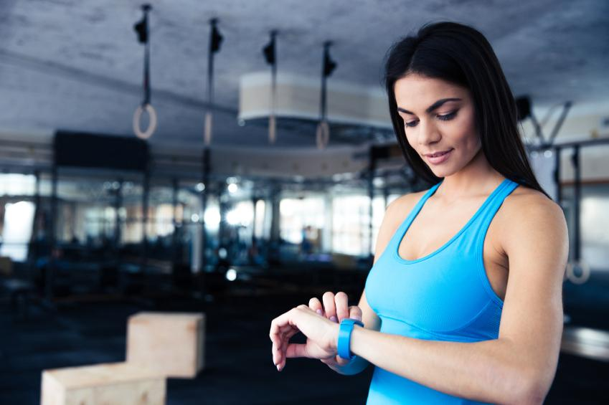
Statistical Analysis of Fitness with Fitbit
Adithya Viswa
September 2022

Slide 2
Our research study encompasses data for a total Of 33 participants whose weight, sleep and Activity are Measured over the course of 30 days

Slide 3
Purpose behind Research
Our Goal is to determine how the trends between Sleep, Daily Activity and Body Weight can affect people meeting their fitness goals and be better informed on the the factors affecting weight loss or weight gain or what the effects of exercise is on getting better sleep

Slide 4

Data Pipeline

Slide 5
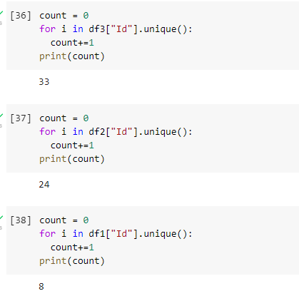
Total of Participants recorded in each log
The datasets provided show that not all participants were recorded Equally in all the datasets but the Activity log one. Due to this, equal
Representation of all participants wasnt available.

Slide 6
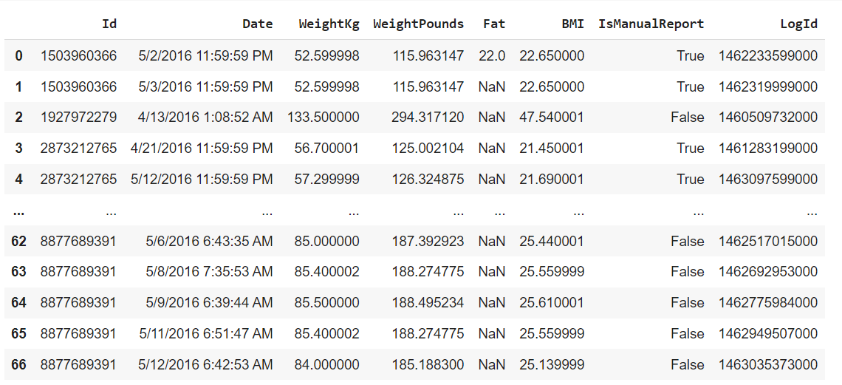
Weight Log Info Dataset

Slide 7
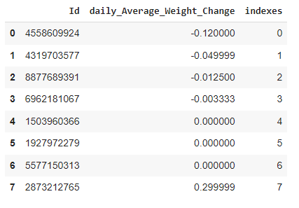
Measuring the Average daily change in Body weight
As interpreted from the Dataframe, some of the participants in the Weight table have on average lost weight while some neither gained or lost weight whereas one has rather gained weight.
Is it plausible to say the one who gained weight gained muscle rather than fat? Could it be that the ones not changing are intentionally doing so by sticking to eating habits?

Slide 8

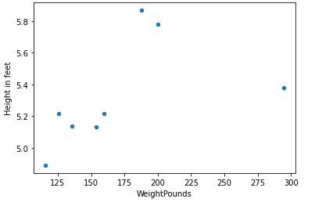
Correlation between average weight and height
Doing a Quick Computation on the Average weight and Average BMI yields us the height of each participant

Slide 9
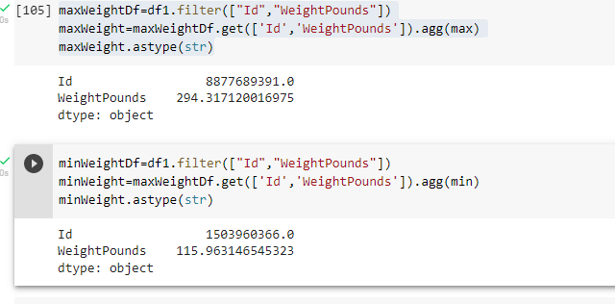
Heaviest and Lightest Participants
hWe can see that the Heaviest participant is user ID 8877689391 who comes in at 294 lbs and the lightest weighing Participant is UserId 1503960366 who comes in at nearly 116 lbs
In the Next slide, we will move onto Sleep Data…

Slide 10
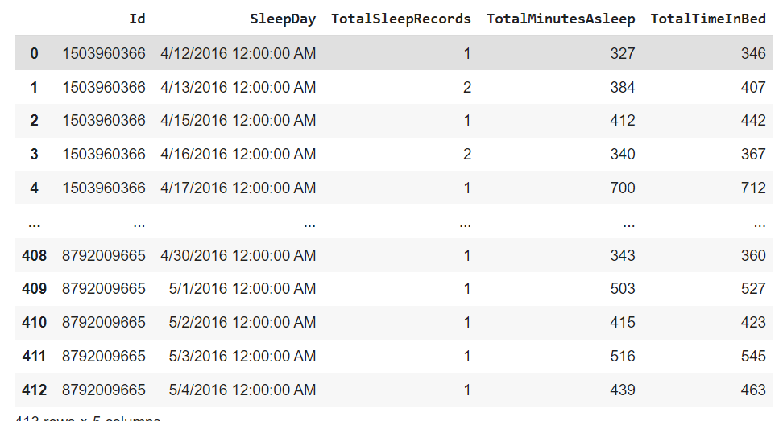
Sleep Log Dataset

Slide 11
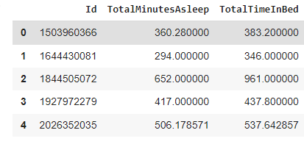
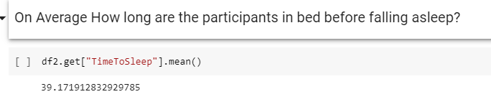
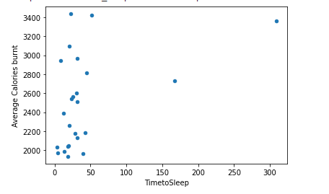


Finding the time it takes Participants to fall asleep
running a quick computation, We were able to create a new column from these 2 that shows the time it takes to fall asleep
Just a quick snippet of a few values in the dataset pertinent to the analysis

Slide 12

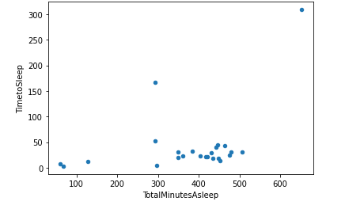

Total time Participants spent sleeping

Slide 13
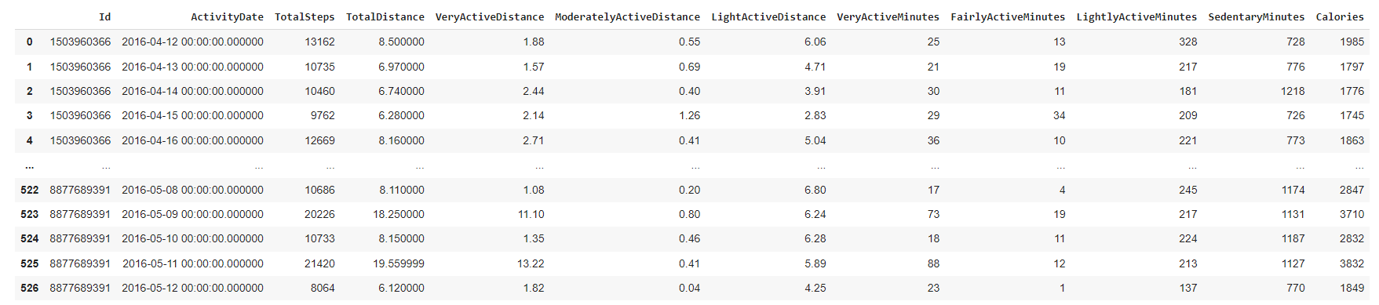
Activity Log Dataset

Slide 14
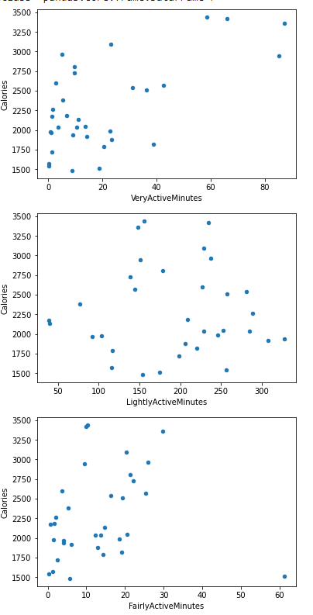
Determining Average Calories burned by Intensity Level
As we can infer through the Graph, there are a lot more people who are lightly active as compared to people who are Fairly Active or Very Active but the majority of the people who are Lightly active are burning FAR less calories than the ones who are Very Active

Slide 15
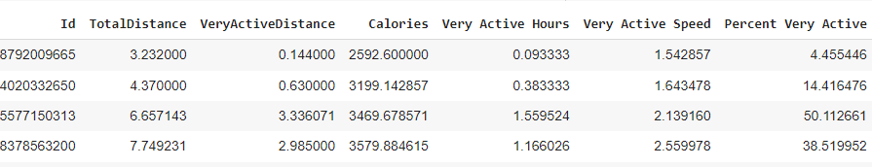
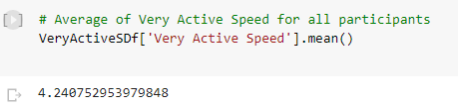

Given the Values of the Distance travelled, the time spent at each intensity level, we were able to calculate the participants average speeds at each intensity level as well as the percent of time they spent in each level
From this Table, We can deduce that the Most active participant is Id#8877689391 and they had an Average Very Active Speed of 6.54 mph and they were Very Active about 52.8% of the time.
The least active was ID#8792009665, they had an Average Very Active Speed of
1.54 mph and were Very Active for only 4.5% of their total workout time

Slide 16
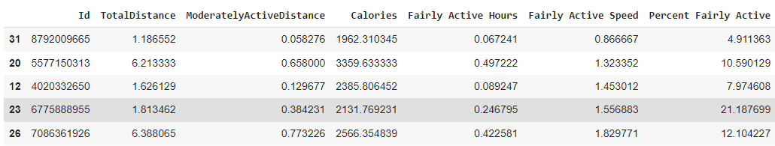
Average Speed for Fairly Active

Slide 17
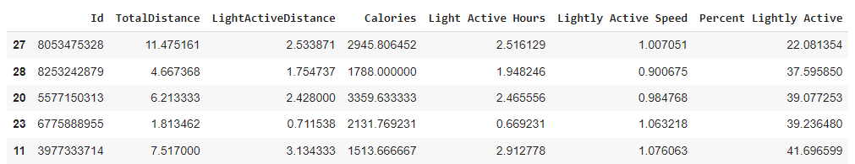
Average Speed for Lightly Active
The Average speed participants remained in the lightly Active Distance is 1.046 mph
The Average Percentage Participants were in the Lightly Active Zone is 67.65 %
People Were more Active in the Lightly Active Period than during any other Intensity Level

Slide 18
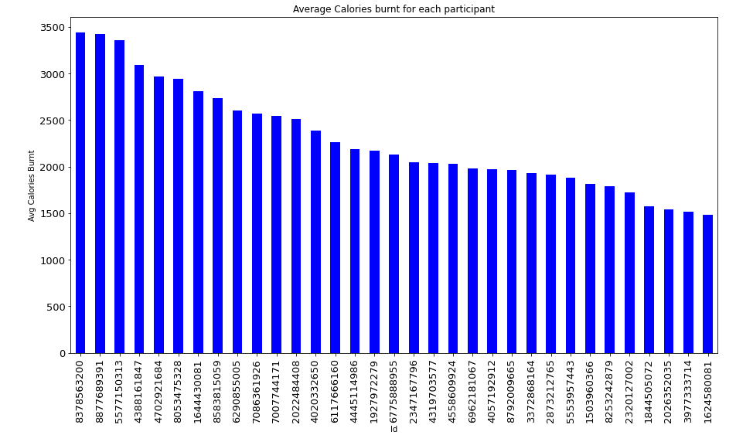
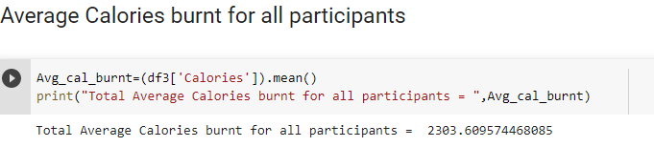
Average Calories burnt per Participant

Slide 19
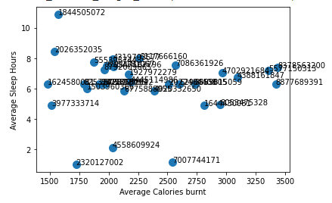
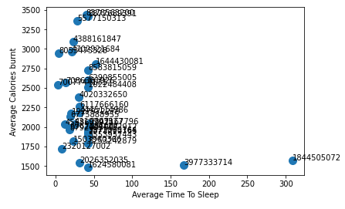
Looking at how many Calories burnt base per participant by hours slept and minutes to fall asleep
Seeing from the Graphs, Its safe to assume that the majority who were doing more than sedentary activity are sleeping on average 6-8 hours and they are falling asleep in under 50 minutes from even light activity with the exception of two individuals who are mostly sedentary and taking longer.

Slide 20
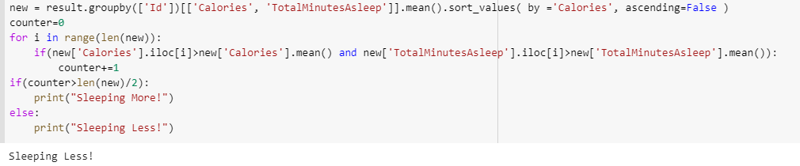
What does the data tell us about the correlation between calories burned and sleep?
How
Ultimately the participants who are sleeping only between 6-7 hours a day are the ones burning the most calories.

Slide 21
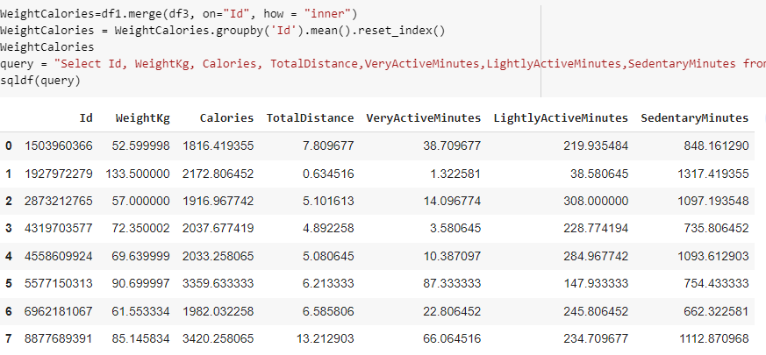
Statistics in regards to body weight and Calories burned
Just this Query Alone gave us all the info needed in regards to Weight, Activity and Calories. We can certainly see that body weight does play an impact on Calories Burned, Total distance travelled and total Activity Level. The 2nd and 3rd heaviest participants burned the most Calories, followed by the first but thats because the heaviest had the most sedentary time and walked the least. The 3rd heaviest recorded participant was the most Active, covered the most distance but is second highest
in spending the most Sedentary time. Lower weight=Lower Calories burned

Slide 22
Predictions and Conclusion
So We can see that the participants on average sleep fewer hours when they are more active. Can we assume from this study that the body actually needs less time resting and Recovering when more active than when not active?
We see that not all participants who are on the heavy side are burning as many calories as expected. Muscle weighs more than fat so is it safe to say the heaviest person who also has the highest BMI may be struggling with body fat % also which is affecting their performance whereas the next two are more muscular hence more active leading to them burn more Calories?
Our Calories burnt data was not entirely activity focused because most people do spend their day being sedentary or not exercising.
Most People were unaffected in how fast they fell asleep based on how many Calories were burned, however we did see that the user with the lowest weight had been the one who slept the least however, the heaviest did not sleep the longest.

Slide 23
Thank You
Adithya Vishwa, Data Analyst
adithyavishwa77@gmail.com

